Slide 1
ISTC 2016 Investigation into Visualization of Prostate Cancer at Early Stage of Development
In the 1st quarter task 2 of the project “Investigation of IR light penetration in prostate tissue in passed mode involved Subtask : 2.1. Investigation IR light penetration dependence on IR light wavelength”.
Aim of the task was to determine that wavelength of infrared irradiation, which is characterized with best penetration in prostate tissue. Experimental materials were obtained after surgical operations. Part of materials was obtained after (trans urethral resection of the prostate) TURP operations and a other part was taken after prostatectomy surgery. Prostate tissue was sliced and placed in the quartz cavity. Thickness of the cavity was selected as 2 mm. Measurements were performed on the spectrophotometer “AvaSepc 2048” of the company “Avantes”. The spectrophotometer is equipped with corresponding software and gives all data on the PC. The spectrophotometer involves wavelengths interval from 300nm up to 1100nm. In the figure 1 is given photography of spectrophotometer.

Slide 2
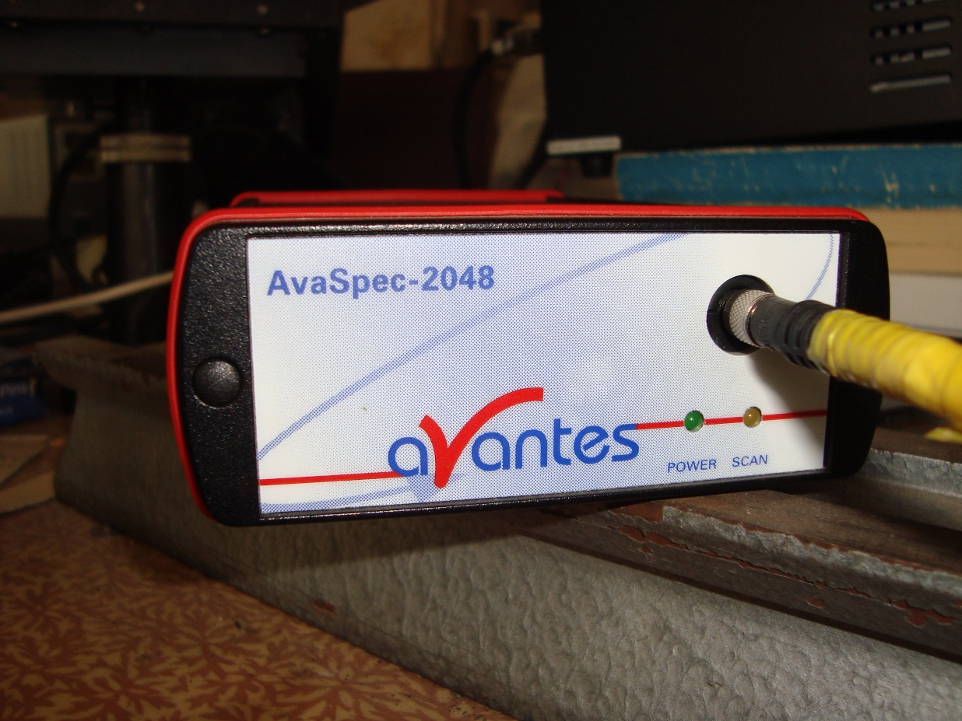
ISTC 2016
Figure 1. Spectrophotometer “AvaSpec -2048”.

Slide 3
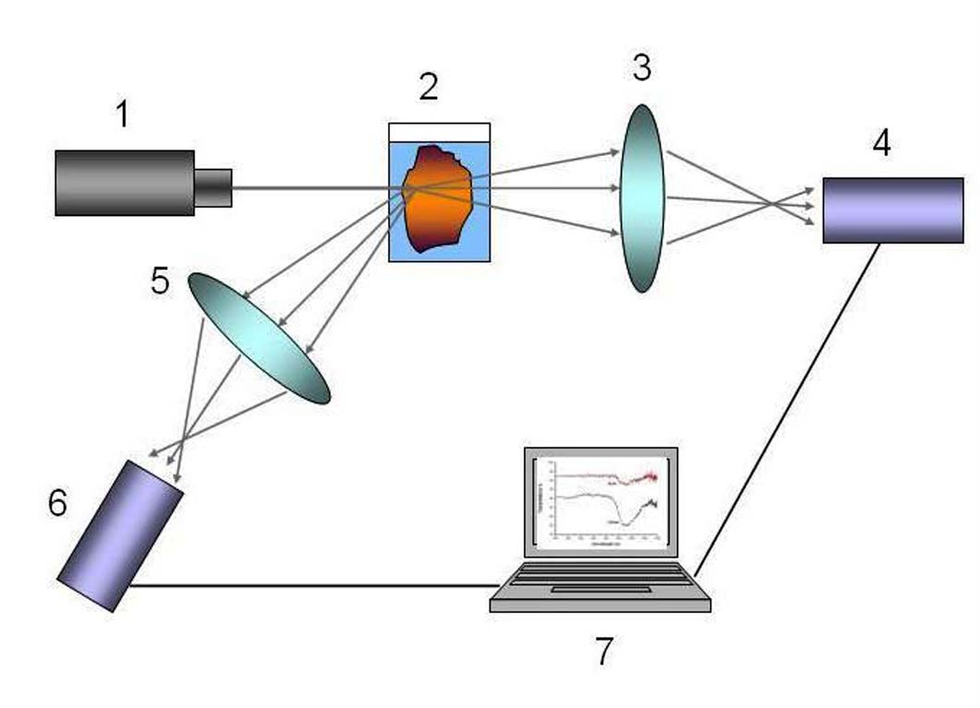
ISTC 2016
In the fig.2 is given schematic expression of the experimental setup
Figure 2. Figure 2. Experimental setup scheme. 1- light source/ 2- cavity with prostate tissue,. 3-lence system 4(6) -spectrophotometer 7- PC.
Setup gives opportunity to work with back scattered mode also. For this case 5 represents lens system and 6 is the spectrophotometer.

Slide 4
ISTC 2016
Total amount of surgery operations was 82. Among them: the number of TURP operations was 53. Number of operations with diagnosis prostate benign hyperplasia -20. Number of radical prostatectomy due to prostate cancer diagnosis was 11. Number of examined tissue sections was more than 200.
Experiments revealed that prostate tissues were transparent to infrared irradiation, while it was not transparent to visible light. Transmission of near infrared irradiation (NIR) in to prostate tissue depends on the wavelength of irradiation. Highest penetration of IR irradiation into prostate tissue was observed in 840-860 nm intervals. However, healthy and malignant tissues had different transmission: namely, highest transmission is observed for healthy tissues and lowest for malignant ones.
In the figure 3 is given infrared radiation transmission dependence on the wavelength for different malignancy prostate tissues.

Slide 5
ISTC 2016-2018
Experiments revealed that visible light does not pass through the prostate tissue. This fabric is impermeable only to infrared rays. Studies have shown that the permeability of infrared rays depends on the wavelength. It was experimentally determined that the highest permeability was found in the interval of 840-860 Nm. been established that healthy and diseased prostate tissues are characterized by different permeability to infrared radiation. Healthy tissue has been shown to have the highest permeability to infrared radiation. The permeability of cancerous tissue is much less than that of healthy tissue. The degeneration of prostate tissue with benign hyperplasia is among the degeneration of healthy and cancerous tissues. Figure 12 shows the results of this study.

Slide 6
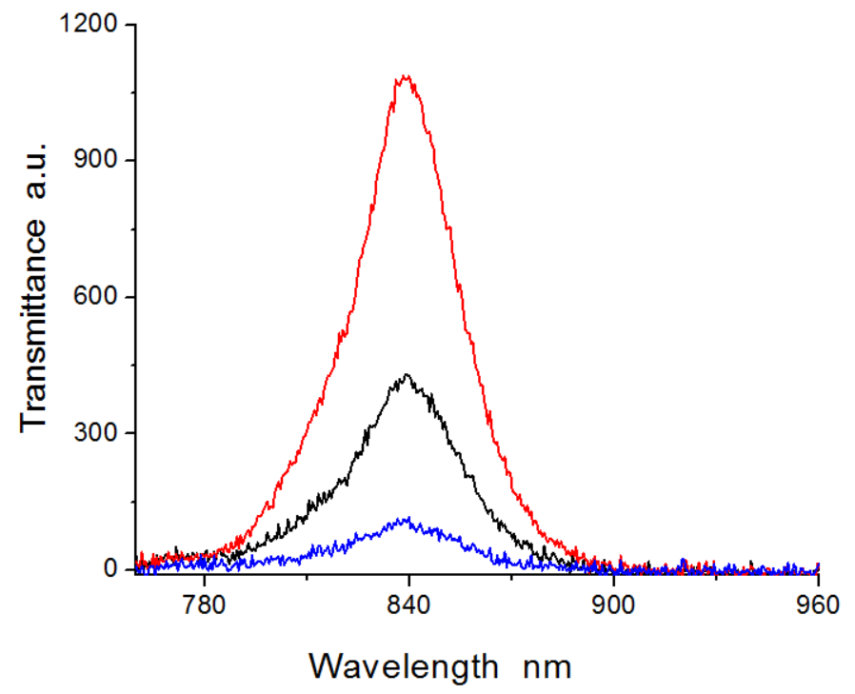
ISTC 2016-2018
Figure 12. Dependence of the permeability of prostate tissues with the same thickness on the radiation wavelength. The red graph is a graph of healthy tissue's permeability from the width of the stem. The maximum decoupling value is 1100 conditional units (p.E.). The Blue graph corresponds to the permeability of the cancerous tissue - the maximum value is 140 P.E. Black graph corresponds to benign hyperplastic tissue. Maximum installment 480 P.E. The wavelength of radiation is measured on the abscissa, the permeability on the ordinate “in conditional units (p.E.)”

Slide 7
ISTC 2016
Fig. 3. Transmittance dependence for prostate tissues of one and the same thicknesses. Highest transmittance was observed for tissues obtained after TURP operations- red plot. Maximum meaning was 1100 a.u. Black plot corresponds to prostate tissue of the same thickness with the diagnosis prostate benign hyperplasia; here maximum transmittance value was 480 a.u. Lowest transmittance had prostate tissue diagnosed as cancerous one –blue plot. Maximum value of transmittance was 180 a.u. Spectrophotometer measures all data in “arbitrary units”.

Slide 8
ISTC 2016-2018
As a result, the wavelength at which all three tissues exhibit the highest permeability is 840 Nm. It was investigated how tissue thickness affected the prostate tissue's permeability to infrared light. The thickness of the prostate tissue affects the permeability of infrared radiation, according to experiments. Permeability decreases with increasing fabric thickness and vice versa. The thickness dependence of infrared radiation on healthy prostate tissue is depicted in Figure 13.

Slide 9
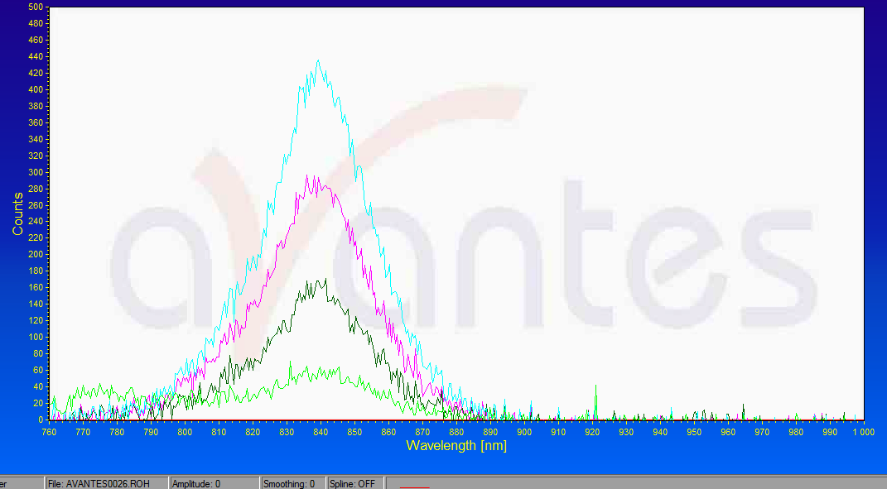
ISTC 2016-2018
Figure 13: Determining the thickness of healthy prostate tissue. Dark green indicates knitwear that is 8 mm thick, light green indicates fabric that is 15 mm thick, blue indicates fabric that is 2 mm thick, and violet indicates fabric that is 6 mm thick. The maximum installment amounts that correspond to this are 435 p.e., 300 p.e., 160 p.e., and 50 p.e.

Slide 10
ISTC 2016-2018
It has been demonstrated experimentally that the maximal permeability value in non-cancerous tissue depends linearly on tissue thickness. This reliance on benign hyperplastic prostate tissues is seen in Figure 14.

Slide 11
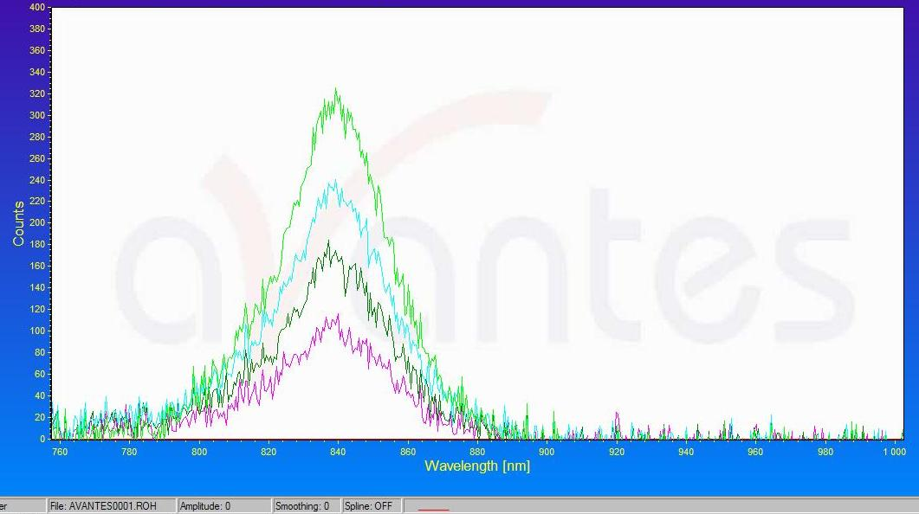
Istc 2016-2018
It has been demonstrated experimentally that the maximal permeability value in non-cancerous tissue depends linearly on tissue thickness. This reliance on benign hyperplastic prostate tissues is seen in Figure 14. Figure 14. Permeability is dependent on tissue thickness. The graph's matching tissues are benign hyperplastic, or non-cancerous. A fabric with a thickness of 5 mm is shown by the light green graph, and the maximum cross-sectional area is 320 P.E. The maximum cross-section value of the blue graph is 220 P.E. for fabric that is 10 mm thick, while the maximum cross-section value of the dark green graph is 170 P.E. for fabric that is 15 mm thick. When applied to 20 mm fabric, the Violet graph has a maximum separation value of 100 p.E. In every instance, the maximum displacement is 840 N in every situation. The radiation wavelength is Nm on the abscissa axis and P.E. on the ordinate axis.

Slide 12
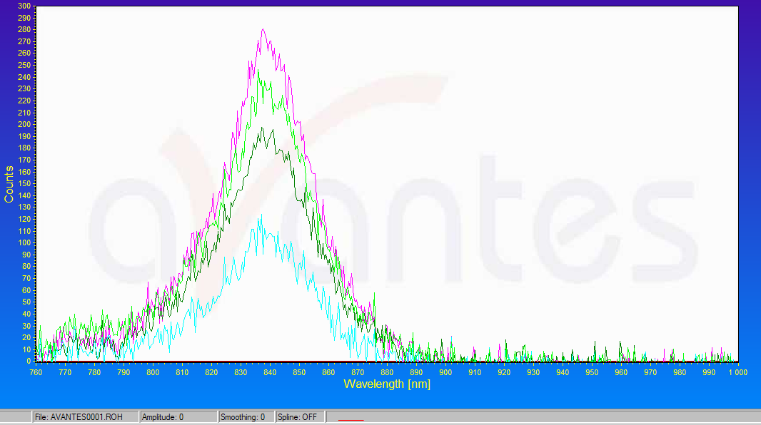
ISTC 2016-2018
Image 15. Tissue thickness and malignant prostate tissues. The cross-section of a 2 mm thick fabric is represented by the violet graph, a 4 mm thick fabric by the light green graph, a 6 mm thick fabric by the dark green graph, and a 10 mm thick fabric by the blue graph. The tethered graph's maximum timeout is 90 P.Th., 280 P.E., 240 P.E., and 185 P.E., respectively.
განჭოლვადობის მაქსიმალური მნიშვნელობის ქსოვილს სისქისაგან დამოკიდებულება ამ შემთხვევაში დაახლოებით წრფივია, მსგავსად ჯანმრთელი ქსოვილისა.
კიბოვანი პროსტატის ქსოვილისათვის ზემოთაღნიშნული დამოკიდებულება არაა წრფივი. მე-15-ე სურათზე ნაჩვენებია კიბოვანი ქსოვილების განჭოლვადობის დამოკიდებულება ქსოვილის სისქისაგან.
Figure 15. Tissue thickness and malignant prostate tissues. The cross-section of a 2 mm thick fabric is represented by the violet graph, a 4 mm thick fabric by the light green graph, a 6 mm thick fabric by the dark green graph, and a 10 mm thick fabric by the blue graph. The tethered graph's maximum timeout is 90 P.Th., 280 P.E., 240 P.E., and 185 P.E., respectively.

Slide 13
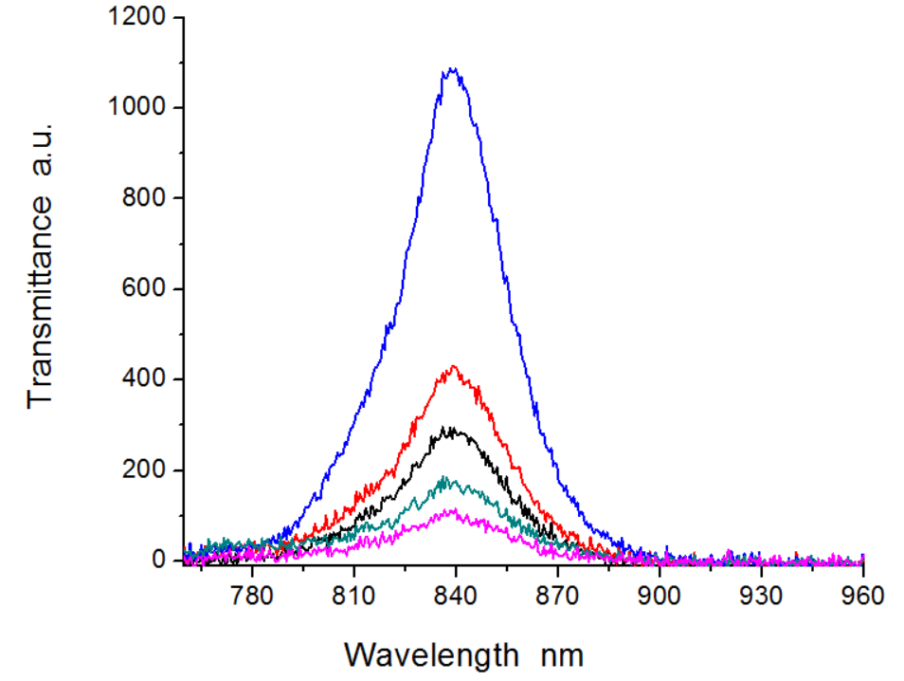
ISTC 206-2018
The dependence of permeability on the intensity of infrared source radiation was studied. For this purpose, emitters of different strengths were used in esperimeters, and the infrared wavelength emitted and the thickness of the fabric were constant. Figure 16 shows one example of this attitude.
Figure 16: The connection between the source's wavelength and intensity. The separation maximum in each instance was charged at a wavelength of 840 nm. When the maximal radiation intensity is 160 MW/Steradian, the source case is shown by the blue graph. The source intensity of 35 MW/stradin is represented by the red graph. Source capacity at 25 MW/Steradian is represented by the dark green graph, source capacity at 10 MW/Steradian by the light green graph, and source capacity at 4 MW/Steradian by the violet graph.

Slide 14
ISTC 2016
The wavelength interval which penetrates prostate tissues involves 780-900 nm.
Meanings of maximum transmittances were measured, set in table and were analyzed by means of “Prizm” software. Average maximum transparency for sections obtained after TURP tissues was equal to 1100 a.u. Seemingly these tissues might be regarded as healthy ones. Average maximum meaning of transparence for tissues with diagnosis of benign hyperplasia tissues is 450 a.u. and for cancerous tissues 100 a.u. The ratio of transparencies for cancerous tissues to TURP ones was equal to 0.09 (p value 0.005).

Slide 15
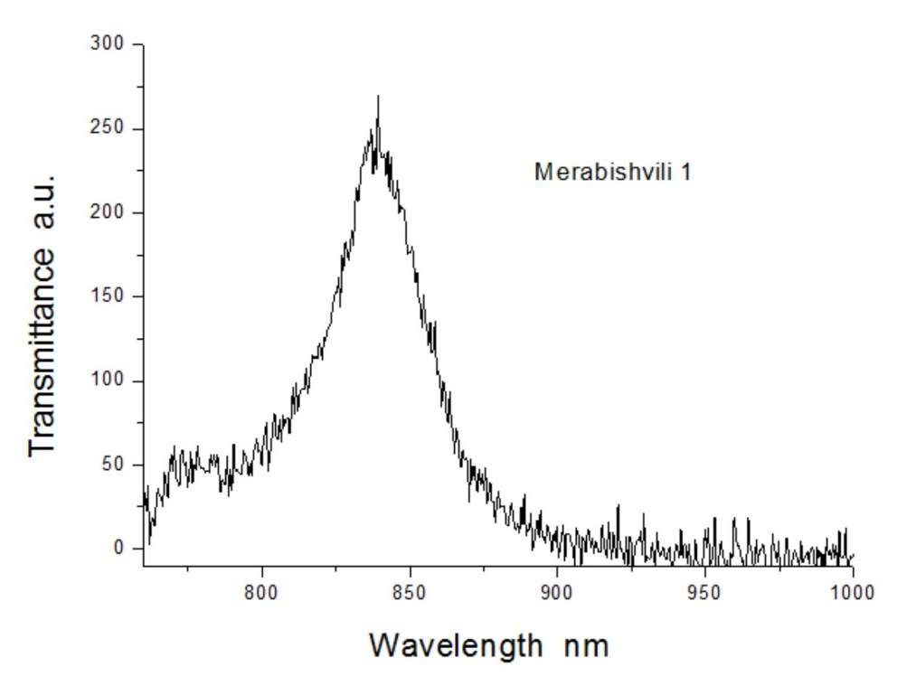
ISTC 2016
Part of experiments was performed on prostate tissues processed in formalin. In the figure 4 is given the graph for one of such prostate tissue.
Figure 4 . Transparence dependence for prostate tissue processed in formalin.
It is noticeable that maximum transmittance occurs at the same wavelength as for other tissues.

Slide 16
ISTC 2016
Observed effects concerning the difference of healthy and malignant tissues different transmittances to IR radiation might be explained as follows:
It is well known generally, that the cancerous cells are characterized by non-controlled and chaotic division. Normal cells have one nucleus and one nucleolus. Chromatins are threadlike before the division. Cancerous cells have more than one large, irregular shaped nucleus and nucleolus, and condensed chromatins. Due to this reason the light penetration in normal and in cancerous cells is not the same, healthy cells are nearly transparent to light, whereas cancerous cells are much less transparent to light. This judgment is also fair with respect to infrared rays, when considering the healthy and cancerous cells of the prostate. Fast drop of plots at 900 nm and higher meanings might be explained by fact that at this region water absorbs IR radiation highly; thereby tissue becomes not transparent to the irradiation.

Slide 17
ISTC 2016
Conclusion for the task 2 of 1st quarter:
prostate tissue is transparent for near infrared irradiation and maximum transmittance is observed at 840-850 nm.
Highest transparence has normal tissue and minimal cancerous tissue.
There is no difference in dependence of transmittance on IR radiation wavelength between tissues processed in formalin and native ones.

Slide 18
ISTC 2016
Task 2 in the 3rd quarter “Investigation of infrared light (IR) light penetration in prostate tissue in passed mode” is part of the subtask “Investigation of IR images of the noncancerous prostate tissues”.
Materials for the task were obtunded from surgical operations. Patient surgical operations are required tasks for all 8 quarters. Thirty one transvesical (open) prostatectomy and 23 transurethral resection of the prostate (TURP) were performed during the 3rd quarter. The advantages of open prostatectomy over TURP include complete removal of the prostatic adenoma under direct visualization in the suprapubic and retropubic approaches.

Slide 19
ISTC 2016
Methods.
Experiments of the 1st and 2nd quarters showed that IR light with 850 nm wavelength has the best penetration in prostate tissues. Thereby in this series of experiments, we examined LEDs emitting this wavelength. We purchased an IR 1000 CCD camera (DAGE-MTI, Michigan City, IN, USA). IR light source and CCD camera were mounted on an ordinary microscope fame. Prostate (or prostate tissue) was placed between the CCD camera and LED. IR light emitted by LED passed through prostate and was captured by CCD camera. The CCD camera in turn was connected to a laptop for processing of IR images. Experiments were carried out in darkness to avoid day light artifact. The experimental setup is shown in Figure 1.

Slide 20
ISTC 2016
SS
Figure 1. Experimental setup.
In figure 1a, arrows 1, 2, 3 and 4 indicated LED, CCD camera, power supply for LED, and laptop, respectively. Figure 1b s hows a prostate placed on Petri dish between CCD camera and LED. NIR light irradiation angle of LED was 90°. CCD camera capture area covered the whole surface of a prostate exposed to it, thereby no scanning was necessary.

Slide 21
ISTC 2016
The setup provided opportunity to obtain prostate transillumination IR images. In the description below, instead of “transillumination infrared (IR) image”, the term “infrared image” or “IR image” is used.
After transvesical prostatectomy operation , whole prostate and after TURP, prostate tissues were delivered for infrared investigations.
We envisage several scenarios of IR illumination of prostate in vivo in the future. Figure 2 shows one of these scenarios. In this case, IR illumination source can be placed in the middle of a prostate gland through urethral channel.

Slide 22
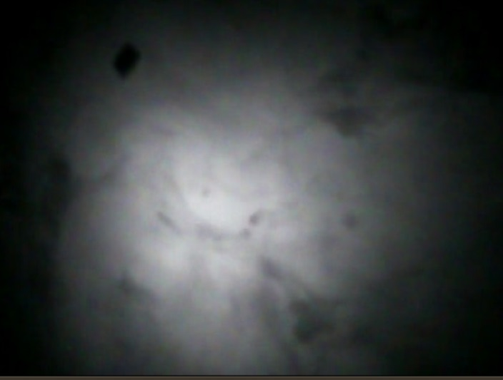
ISTC 2016
In another scenario, IR source with much higher power can be tightly put on the abdomen outside the body. Thus, prostate irradiation management will be an important feature for designing of future devices. For this reason, we have examined LEDs with different emitted powers and different angles of irradiation. Concentration of irradiated energy is higher in LEDs with narrow angle of irradiation in comparison with LEDs with wide angles. Irradiation of the prostate with narrow angle LED (6°-45°) gives opportunity to observe only a small part of the prostate in IR light (Figure 3).
Figure 3. Left picture represents IR image of prostate with LED irradiated angle of 15°. Right picture was obtained using LED with irradiated angle of 45°. Comparison of the two images indicates that, in the case shown on the right picture, IR light covered wider area of the prostate. Bars on the bottom of the pictures correspond to 1 cm length.

Slide 23
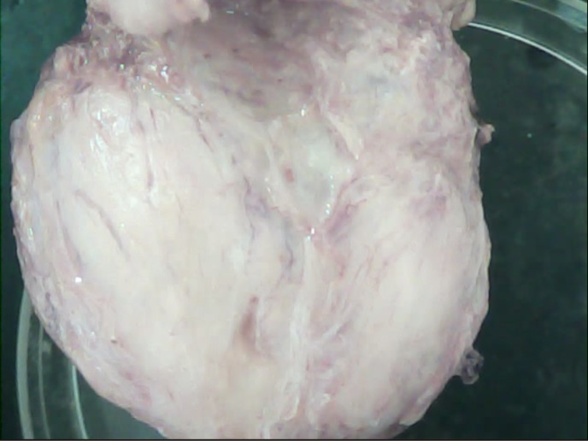
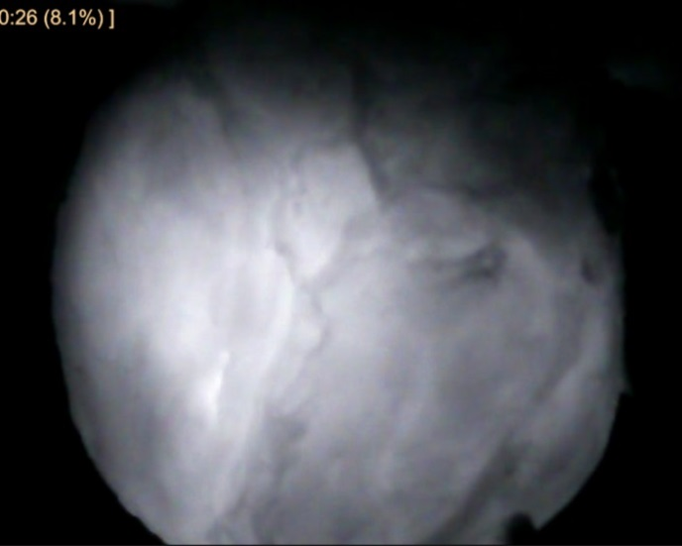
ISTC 2016-2018
LEDs with very wide angle of irradiation (about 150°) captured whole prostate volume and area beyond it. The optimal condition occurred with LEDs with 90° angle of irradiation. Experiments revealed that quality of IR image depended on the irradiated energy. Selection of corresponding irradiated energy was necessary to obtain optimal IR image -(Figure 4).
Figure 4. Picture on the left shows prostate image in reflected daylight rays. Image was obtained by CCD camera. IR image of the prostate is shown in the right picture. LED with irradiated energy equal to 90 mw/sr (milliwats per steradian angle) was selected for obtaining proper IR image. The angle of irradiation was 90°.

Slide 24
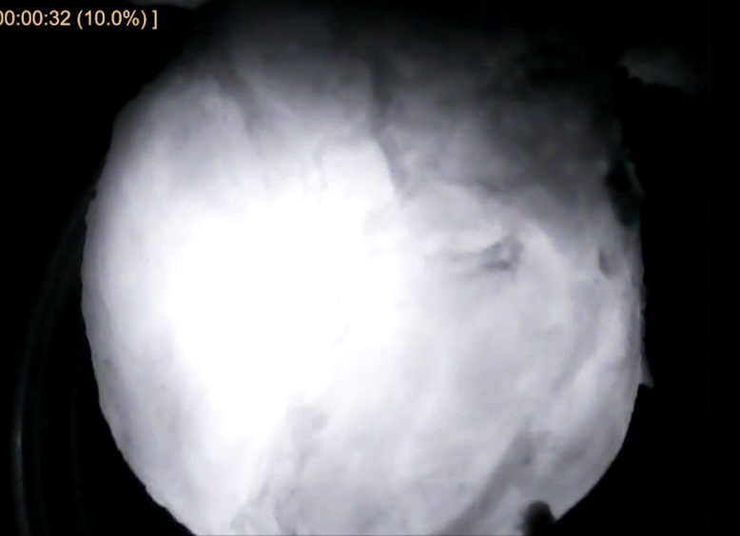
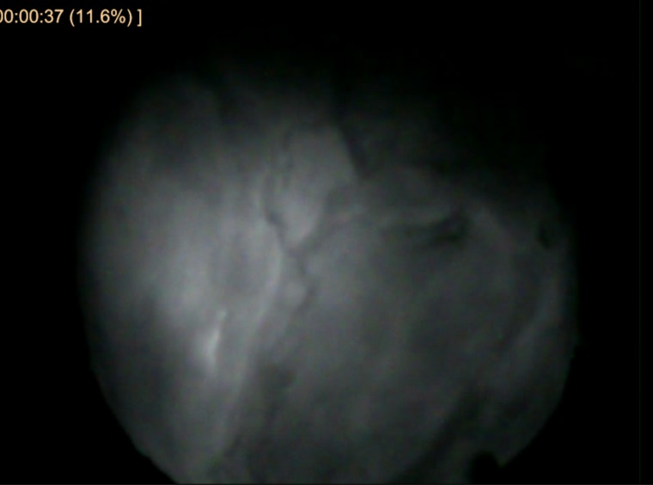
ISTC 2016-1018
When irradiated power was lower or higher then the optimal value, it became not possible to view clearly details of prostate tissue in an IR image (Figure 5).
Figure 5.
IR images of the same prostate as in Figure 4 at different brightness. LED irradiated energy was 130 mv/sr in the left picture and 30 mw/sr in the right picture. Both images do not provide enough details to distinguish well IR image structures of prostate tissue.

Slide 25
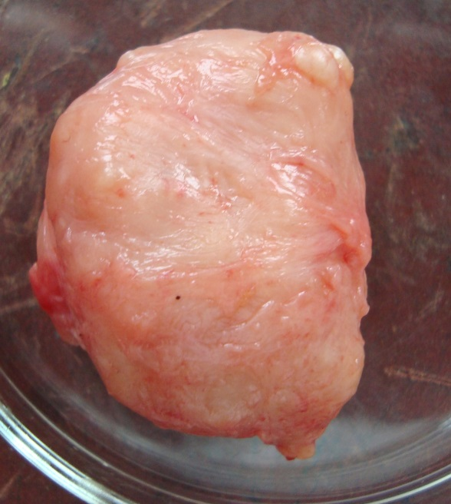
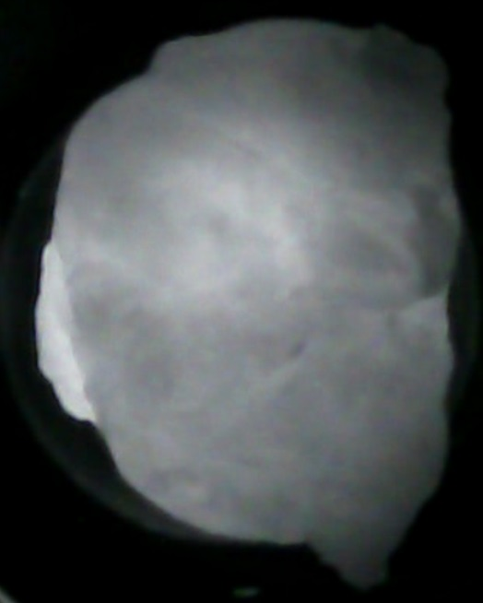
ISTC 2016-2018
IR light is subjected to multiple scattering when it passes through biological tissues and particularly prostate tissue. Thereby, brightness of IR image of noncancerous prostate tissue (with diagnosis of benign hyperplasia) depends on thickness of the tissue (size of prostate). As thinner is the tissue at certain area of prostate, the brighter is the IR image, and vice versa. (In other words the brightness of IR image depends on the length of path passed by IR light). Brightness is homogenous for one and the same thickness of tissues.
Figure 6. Effect of different tissue thicknesses on IR image. On the left side is shown prostate photograph under normal light. On the right hand side is shown an IR image of the prostate. The brightness might be regarded as homogenous besides a small part indicated by the arrow, where IR image is brighter. It is easily noticeable on the photography (left) that this part of prostate is thinner than the rest of it.

Slide 26
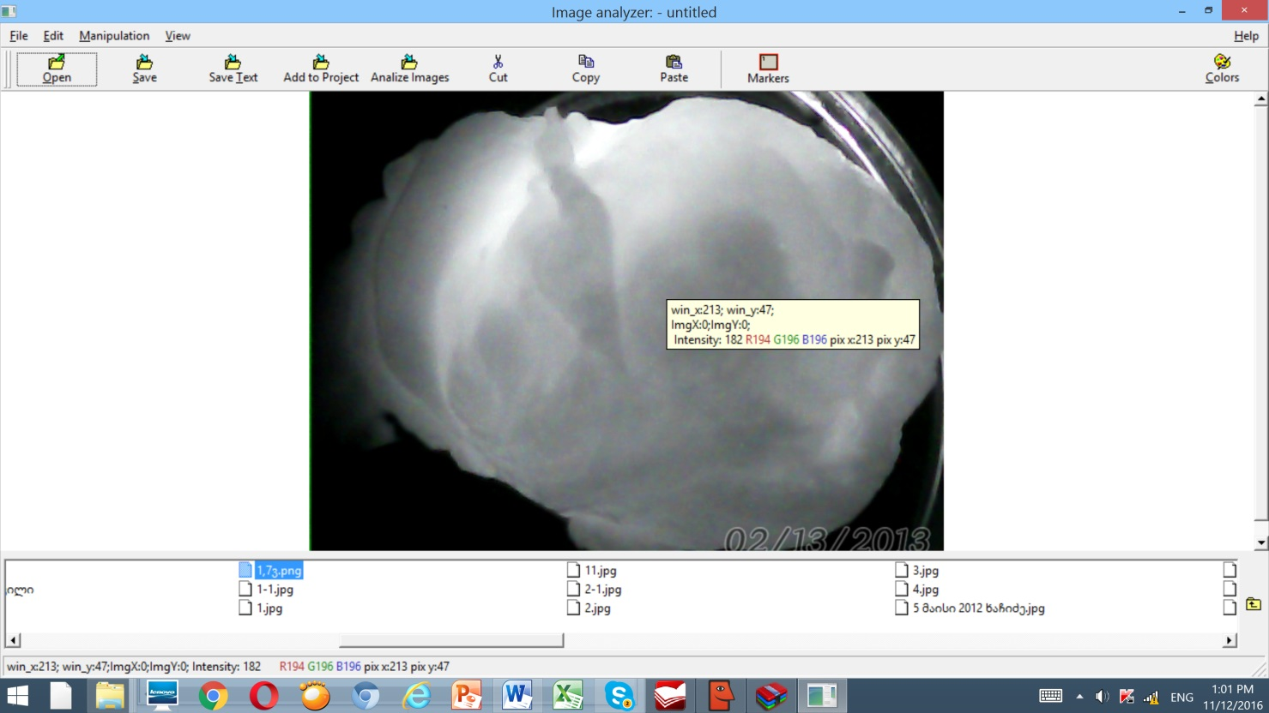
ISTC 2016-2018
Human perception of light brightness is subjective. By this reason, we are developing a software (PC program). The principle is as follows: the program classify the brightness of the IR image into 256 degrees. The number 255 corresponds to absolute white image, i.e. to idealized case when NIR light enters into CCD camera through a prostate without any absorption; and on the other hand, 0 corresponds to an absolute dark image, i.e. when no NIR light enters CCD camera, i.e. idealized case when prostate absorbs entirely the IR radiation. Software envisages marking of certain areas. Software measures IR intensities at all points of marked area then calculates average value of these intensities (and corresponding number appears at the marked area). Figure 7 shows software interface with IR image
Figure 7. Here we see measured intensity at one point of IR image (equal to 182).

Slide 27
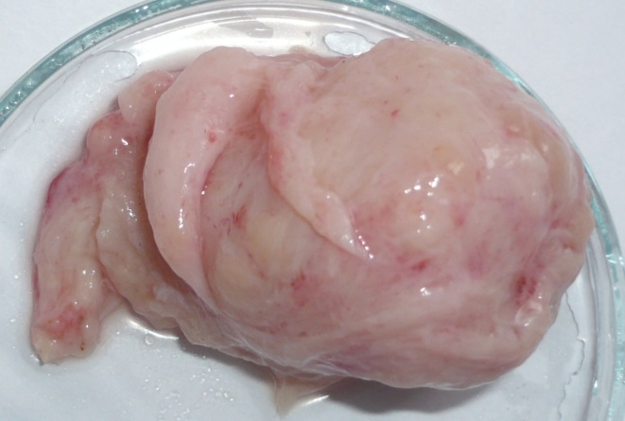
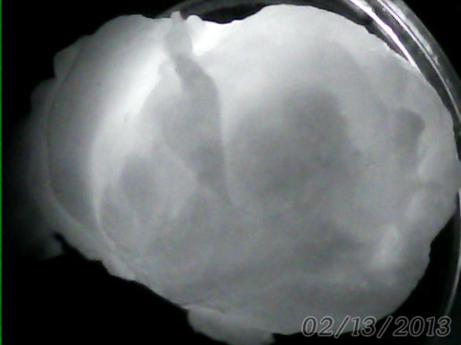
ISTC 2016-2018
Figure 8 shows photography of the same prostate in Figure 7 and its IR image. Difference in brightness on the IR image was caused by difference in prostate tissue thickness at certain areas, which is clearly illustrated in this figure.
Figure 8 Left- prostate photograph in normal light. Rigth- IR image of the prostate. Arrows with same color show areas on the prostate photograph and corresponding areas on the IR image.

Slide 28
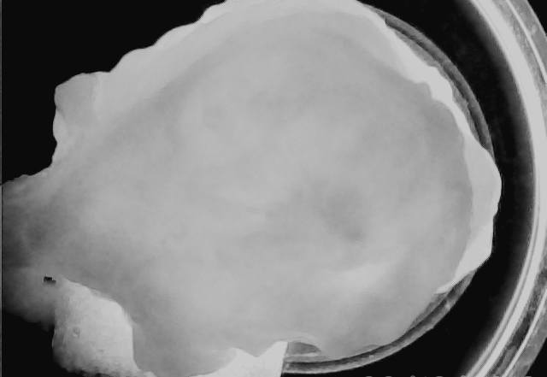
ISTC 2016-2018
After surgery prostate tissue usually is placed in formalin for future processing. We have shown that obtaining of prostate IR image does not depend on treatment in formalin. Figure 9 shows an IR image one of such prostates.
Figure 9. Thickness of prostate tissue was nearly homogenous. Consequently, IR image is characterized with homogenous brightness also.

Slide 29
ISTC 2016-2018
Conclusion:
Brightness and quality of IR image depend on the irradiated angle of the LED.
Brightness and quality of IR image depend on irradiated energy per steradian.
Brightness of IR images of noncancerous prostate tissues with homogenous thickness and diagnosis of beaning hyperplasia is homogenous.

